Slide 1
FEAS AND IT'S MEMBERS
CASES
2023

Slide 2
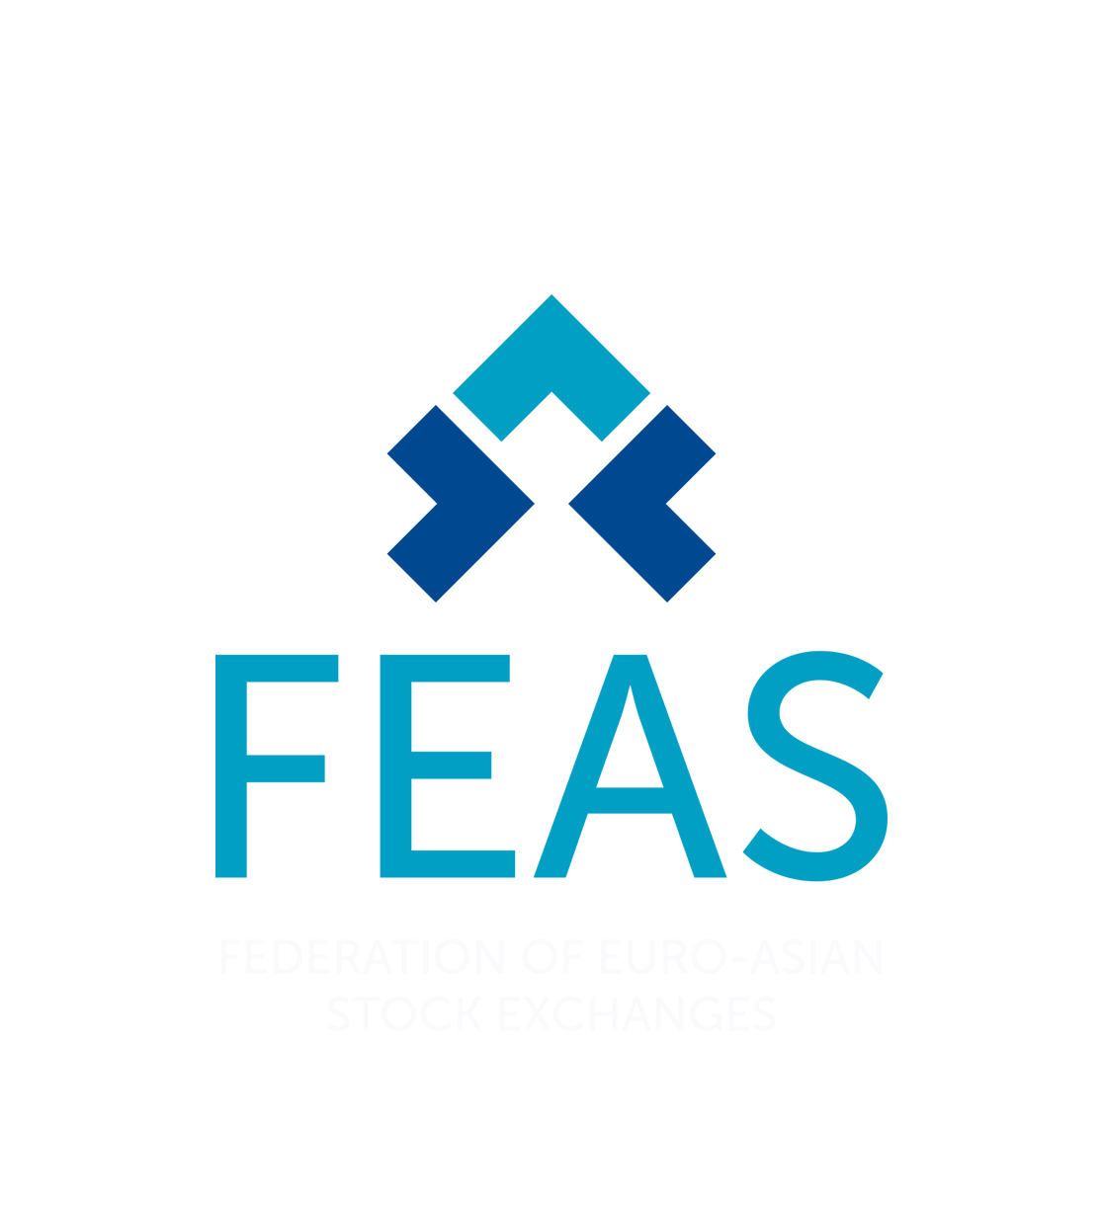
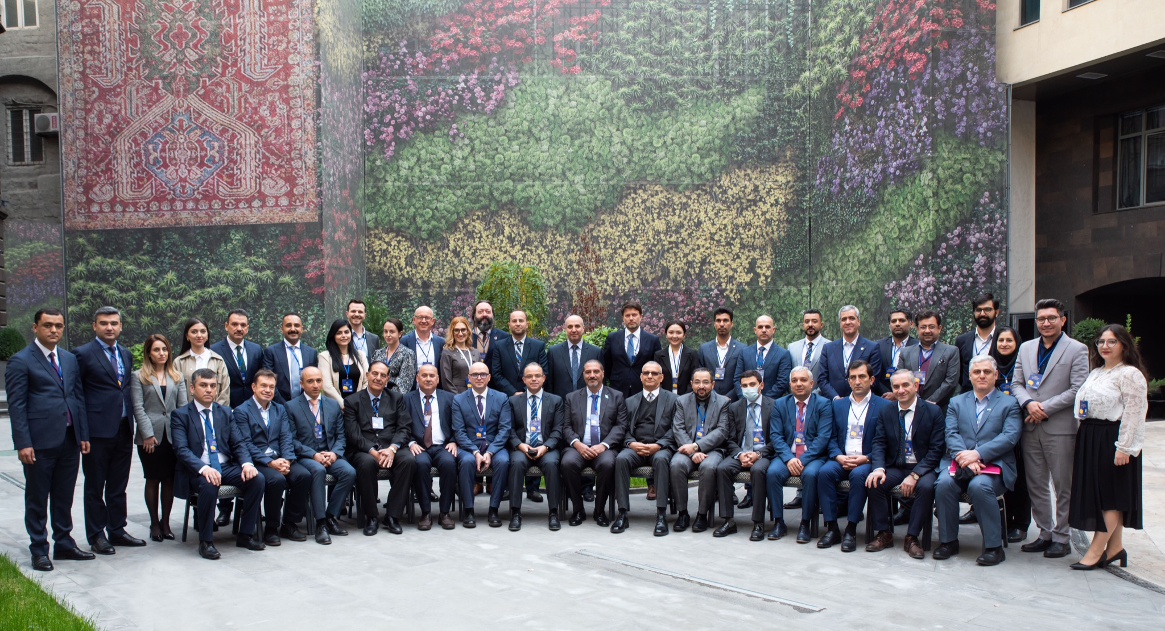
About FEAS
The Federation of Euro-Asian Stock Exchanges (FEAS) was established on 16 May 1995 in Istanbul with 12 founding members.
In 2017 FEAS has moved its headquarter to Yerevan, Armenia.
The mission of the Federation is to contribute to the cooperation, development, support and promotion of capital markets in the Euro-Asian Region (i.e. Europe, Asia and the Mediterranean Basin).

Slide 3
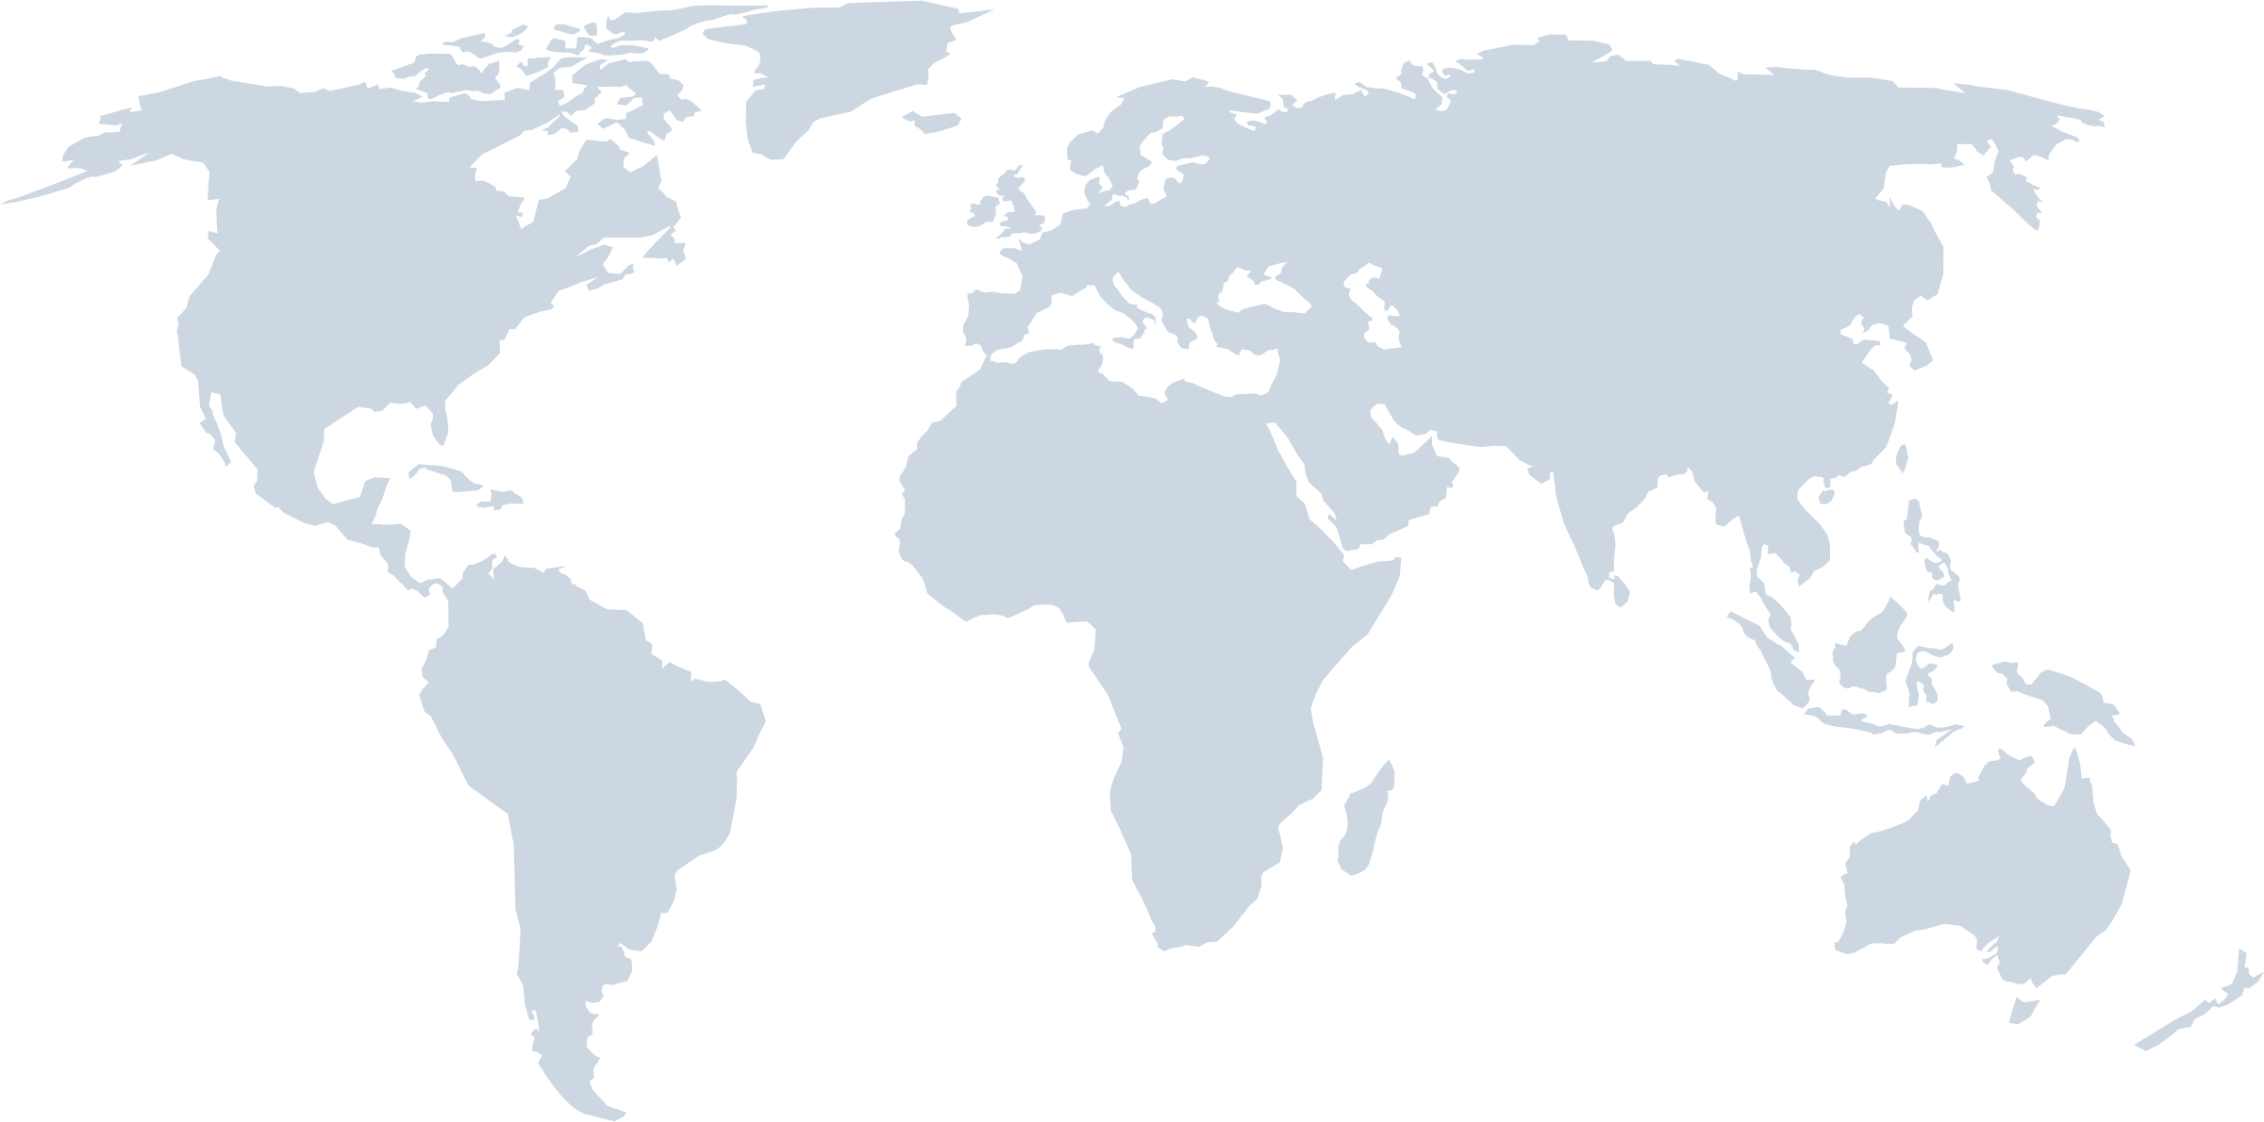
FEAS Members
21 Full Members
10 Affiliate Members
9 Observers
4 Partners
From 31 Countries

Slide 4
WHAT WE DO
FEAS ACTIVITIES

Slide 5
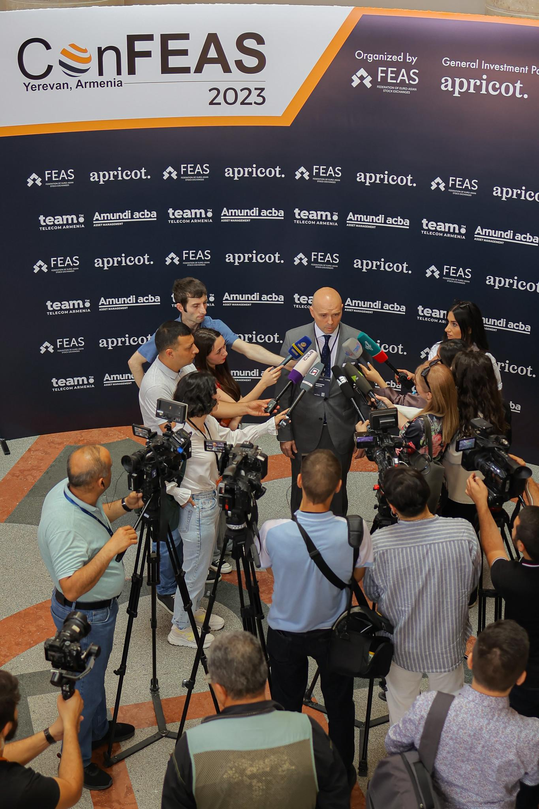
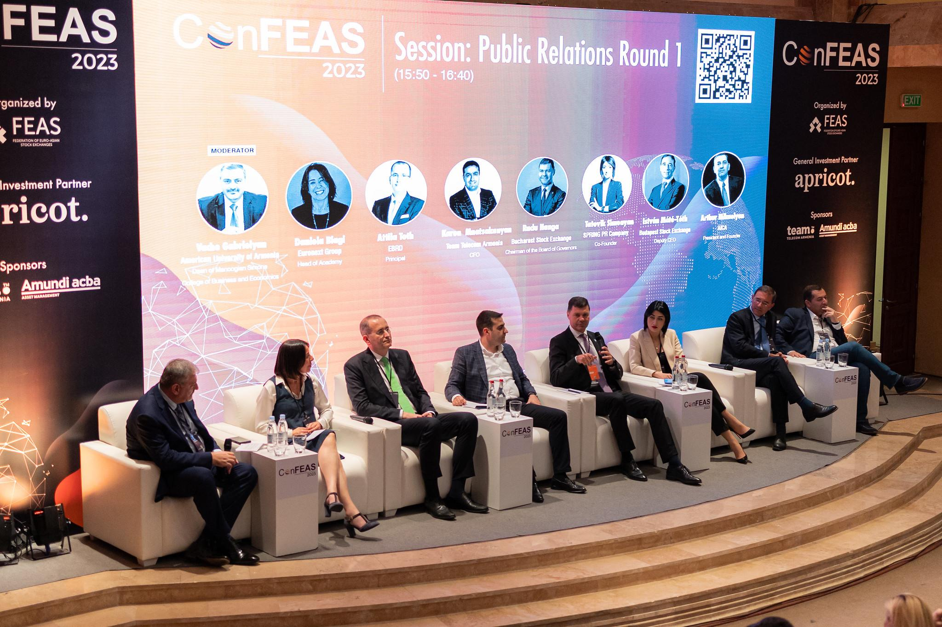
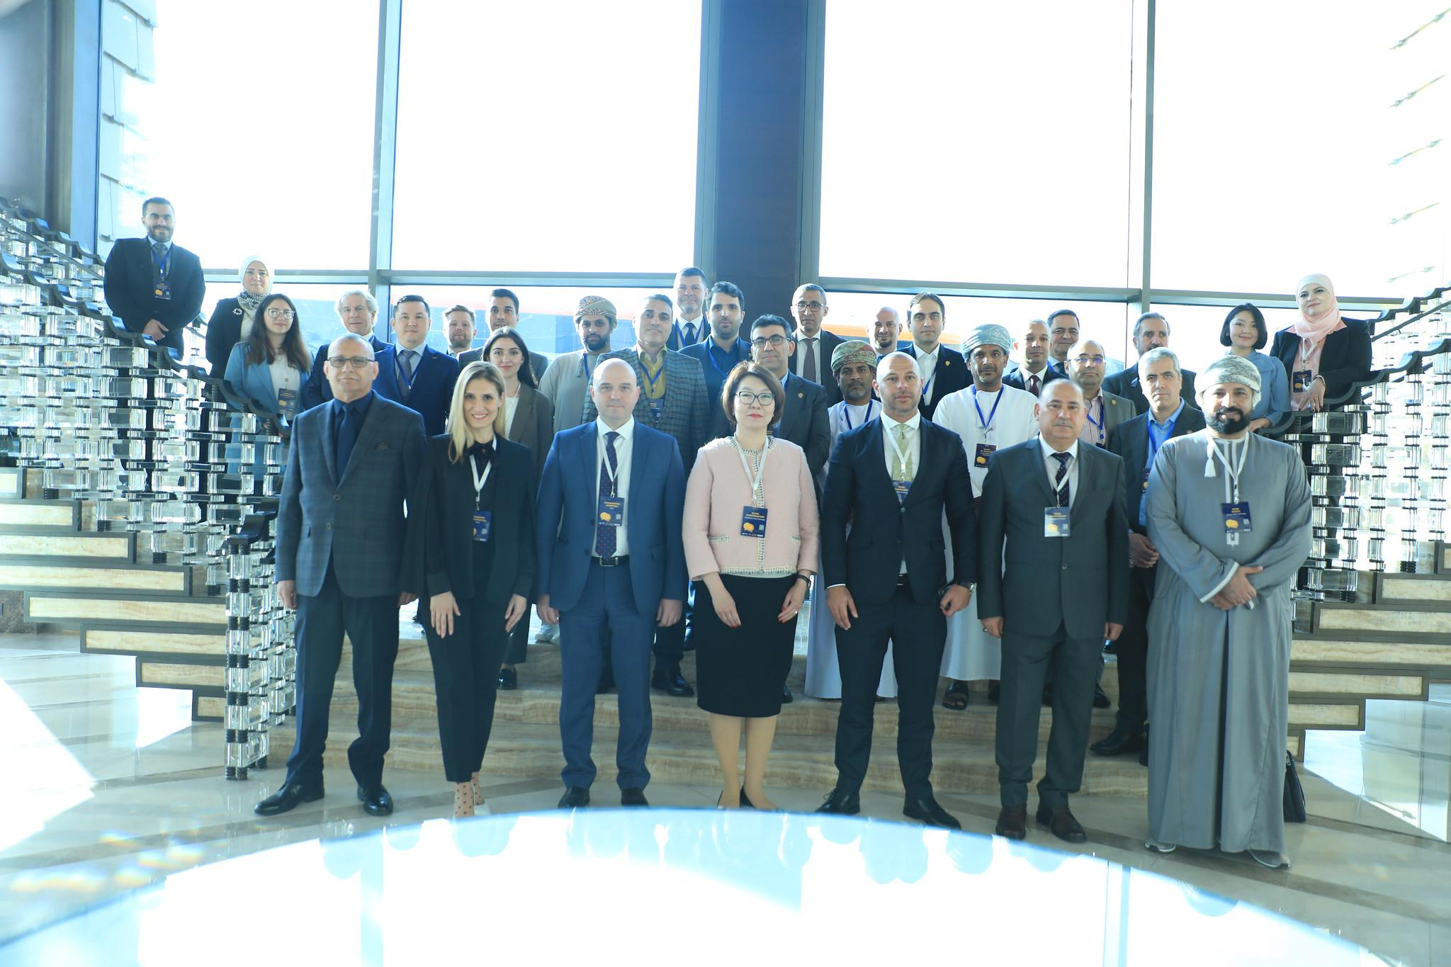
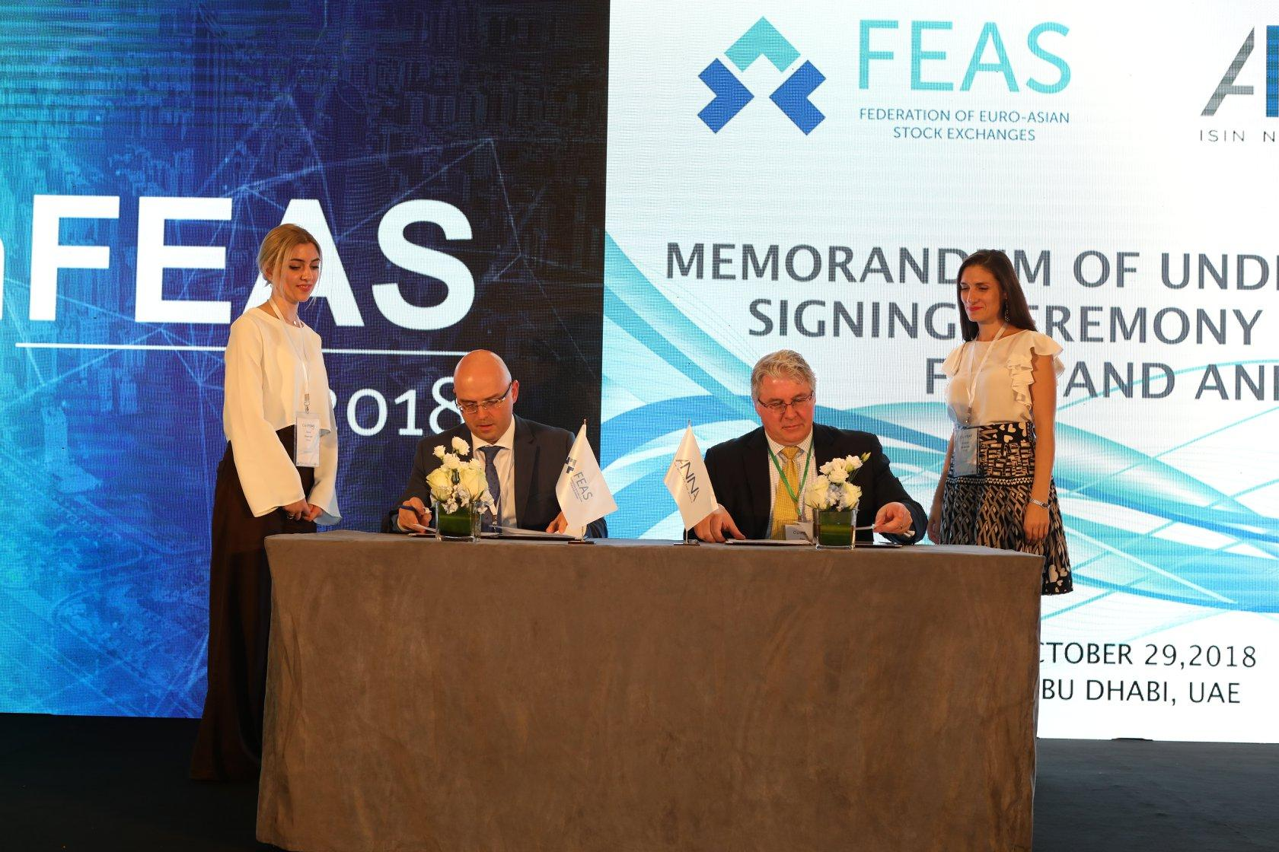
What we do?
Business Support
Cooperation
Training
Research
Networking Platform
PR and Awareness
Education
Events

Slide 6
WHAT OUR MEMBERS DO
CASE STUDIES

Slide 7
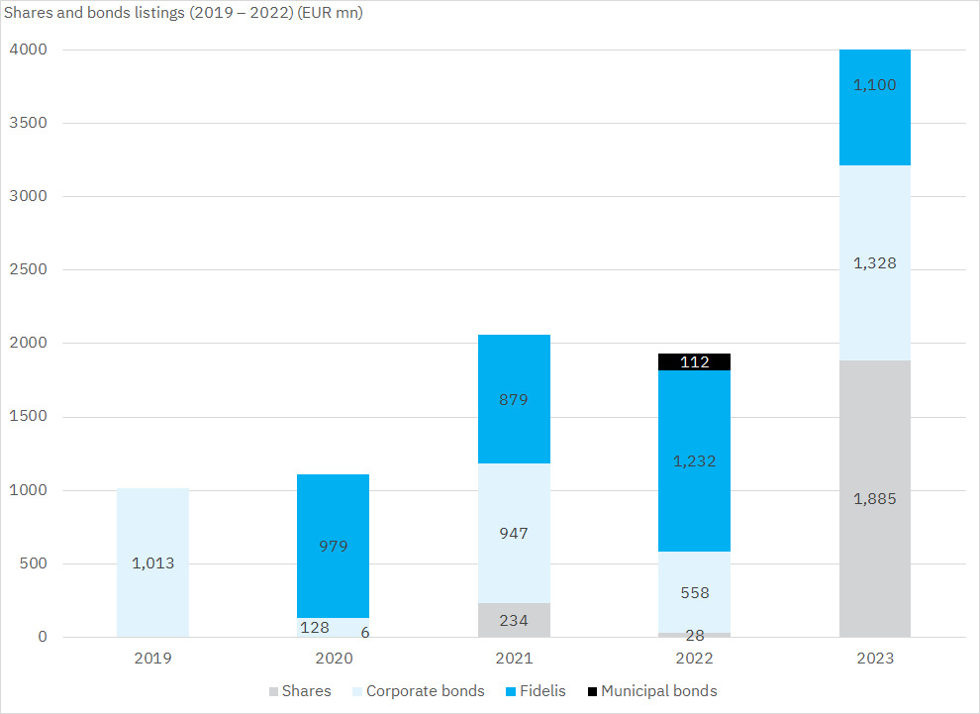
Made in Romania
Bucharest Stock Exchange - Expanding Supply
75 Finalist Companies
100 mln Bonds on Regulated Markets
+ 1000 Nominated Companies
13 Stock Listings
+200 mln Bonds on the AеRO Market
Legislation change and harmonization with the European legislation
‘Made in Romania’ program
Platform dedicated to investors, consultants and companies with growth prospects
Before 2014
2014
Launch of AeRO market: alternative trading system designed for listing of early-stage companies, start-ups and small and medium-sized enterprises
2018
2023
Result:
Significant change in share and bonds listings
Notes:
2014 - AeRo Market The development of this platform positions the Bucharest Stock Exchange as the main financing channel for Romanian entrepreneurs. At the same time, the platform is dedicated to investors, consultants and, in particular, companies with growth prospects, who want to attract financing from investors or who are in the process of preparing a private placement on the AeRO Market or the Main Market. Media content made available by consultants through the platform supports companies in implementing best practices and preparing the business for the next level of development.

Slide 8
Justice Shares
Iranian Capital Market - Expanding Demand
Article 44 of Constitution
obligates the Government to move toward economic privatization no more than 40% of total shares in Justice Scheme
3 deciles - $118 shares per person
Started: 2006
Target: six lowest income deciles
3 lowest deciles - $236 shares per person
Ministry of Economic Affairs and Finance
Privatization Organization of Iran (IPO)
32% of the capital market value is allocated to the "Justice Shares" release
scheme
Limitation on share allocation
CSDI
Allotment
Opening trading accounts (≥40 mln)
KYC
Settlement
Corporate actions
President - Deputy Minister
49 million holders
(55% of total population)
49 companies in the project
36 listed in the stock exchange

Slide 9
Market Concentration
Kazakhstan Stock Exchange
Market Efficiency
Financial and Operational Efficiency
Palette of Instruments
Shares (ordinary,preferred)
Bonds (corp and gov)
Discount notes
Funds
Depository receipts
Currency
Currency swap
Futures
REPO
Collateral certificates
Liquidity concentration
Technologically efficient
Efficient risk management
Easily Configurable

Slide 10
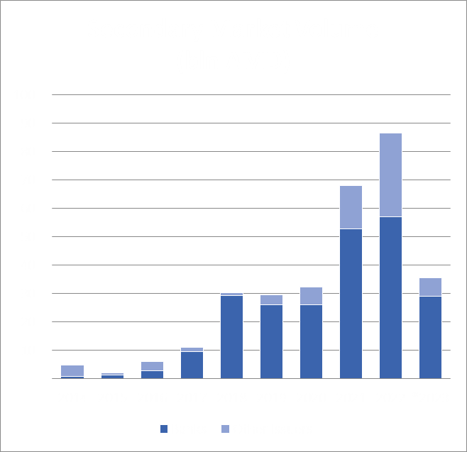
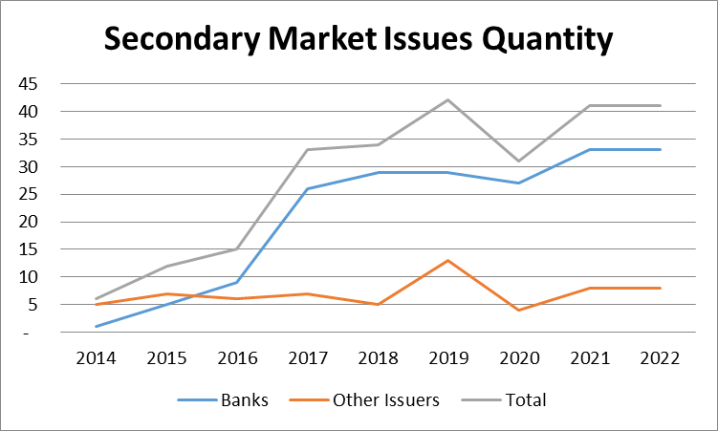
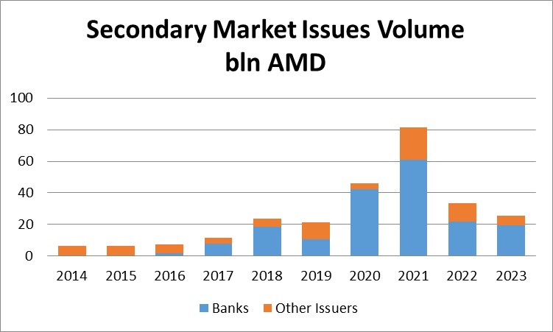
Regulatory Incentives to Boost Bond Market
Armenia Securities Exchange
Incentive
Change in regulatory norms by reducing the mandatory reserve of banks up to 0 for the issued bonds in Armenian Dram.
Result
2014 - 1 bank issuer
2015 - 4 bank issuers
2023 - 14 out of 18 banks are bond issuers in local and foreign currencies

Slide 11
THANK YOU!
FOLLOW US
www.feas.org

